Slide 1
BPI Data Analysis System
A presentation by Brijgopal Bharadwaj

Slide 2
Overview:
Project Aim
Objectives
GUI – a synopsis
Error Handling
File structure
The algorithm for each process.

Slide 3
Project Aim:
To design a GUI-based system for predicting the state of the beam, based on the corresponding beam-position inputs.

Slide 4



Objectives (so far…):
Data accumulation
Data assimilation
Data wrangling
Data representation
Clustering analysis
Summarizing observations
Visualizing results
Documentation

Slide 5
Data Accumulation:
Understanding the API-structure of the ‘SRS2’ data-servers.
Assessing the Nature & Speed of response of different APIs.
Selecting suitable commands for issuing the required HTTP requests.
Converting the response data in a processing-ready format.
Data Assimilation:
Understanding the values, range & significance of various data attributes.
Determining the sequence of processing of the different created data-sets.
Determining the list of inputs to be taken from the user.
Exploring ways to make the communication with the user & the ‘SRS2’ servers simple and efficient.

Slide 6
Data Wrangling:
Transforming the data-sets to fit the needs of further analysation.
Creating derived data-stores with relevant subsets of information.
Writing raw data to files for future reference.
Identifying the operational cycles from the available data, and separating them for further analysis.
Passing the data-stores to GUI’s global handle to ensure code-modularity.
Data Representation:
Displaying the data & the results in a easy-to-understand and visually pleasing manner.
Adding the options to interactively obtain insights through the use of graphic-inputs.

Slide 7
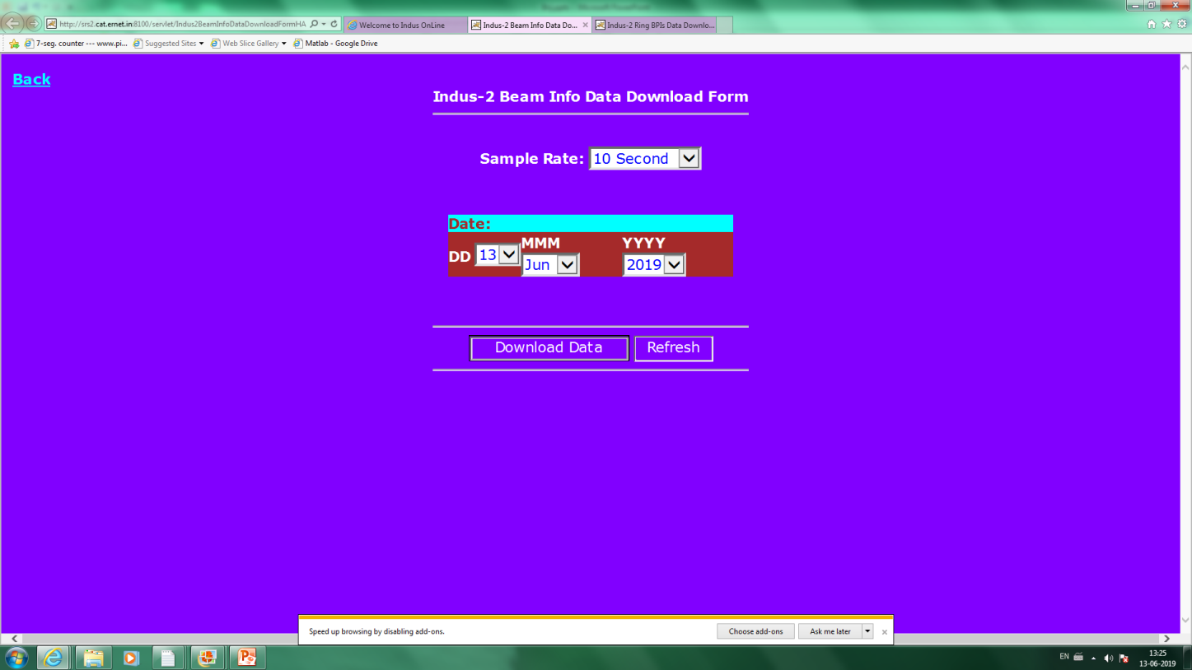
The data-source:

Slide 8
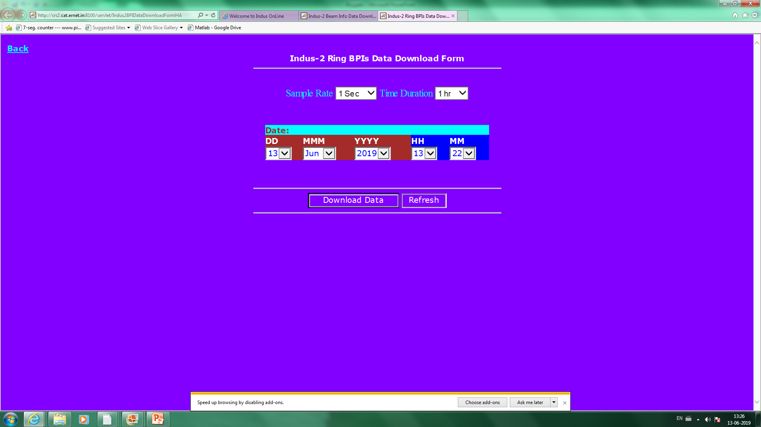

Slide 9
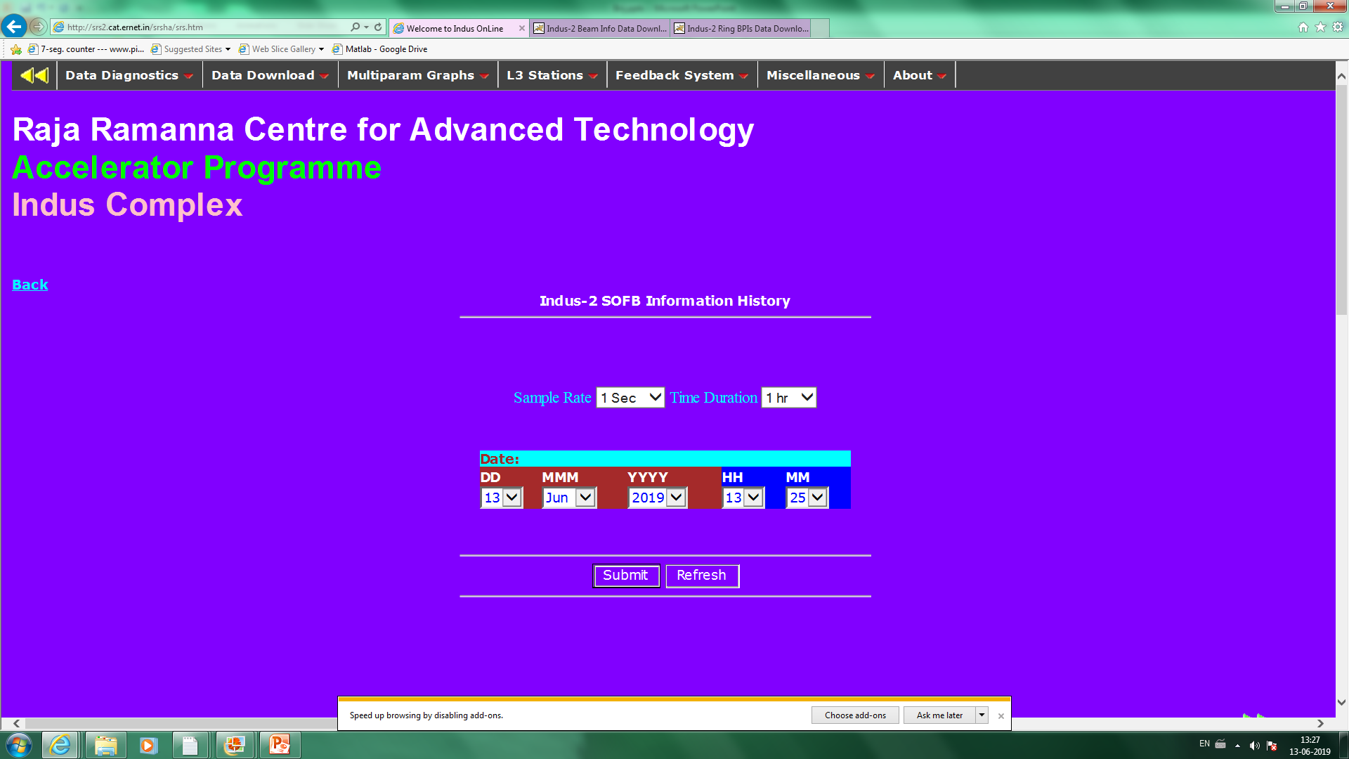

Slide 10
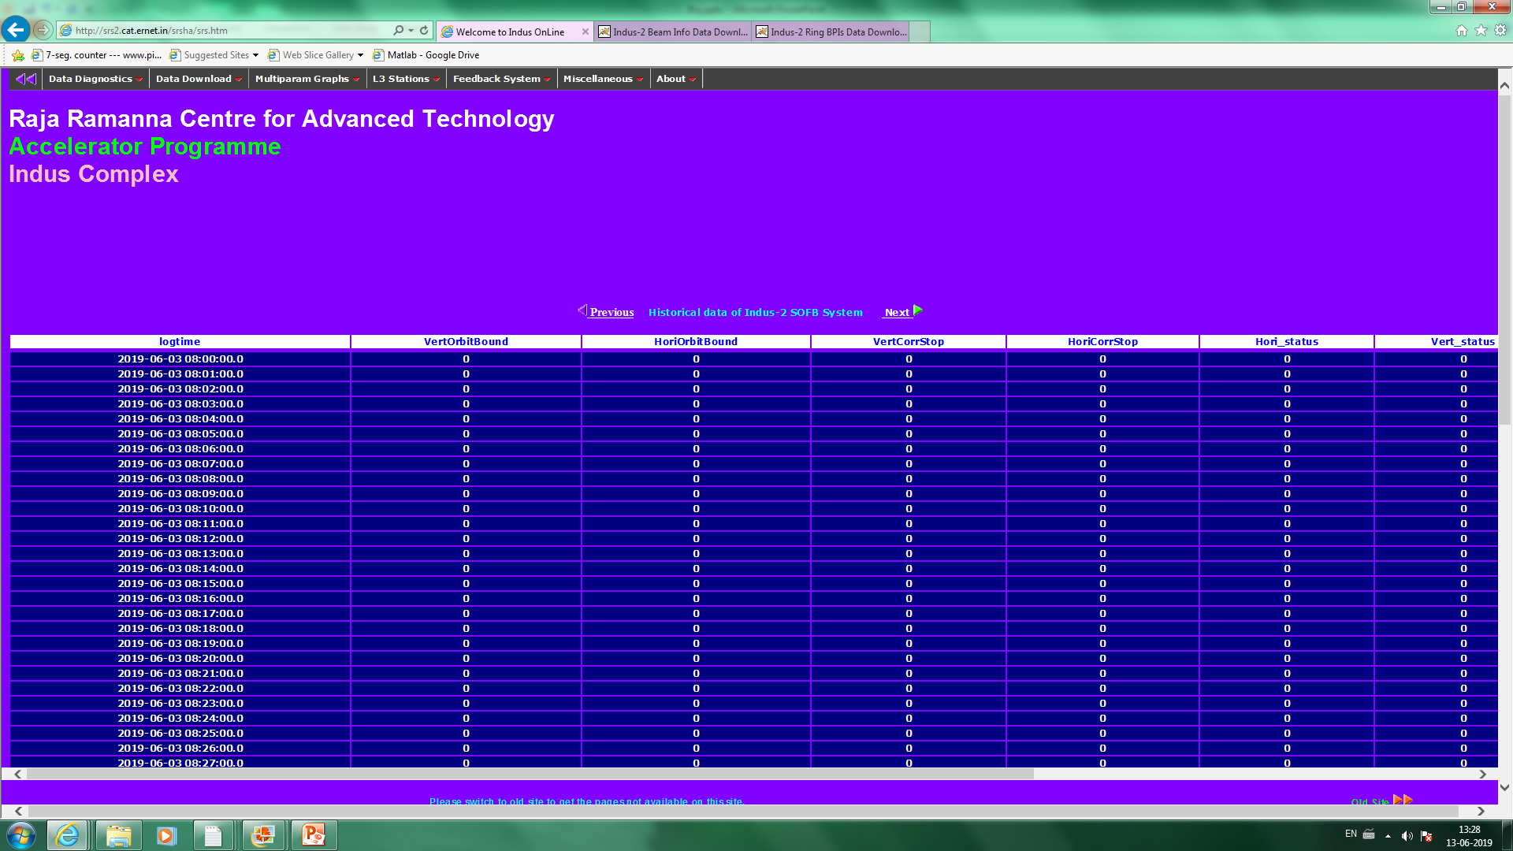

Slide 11
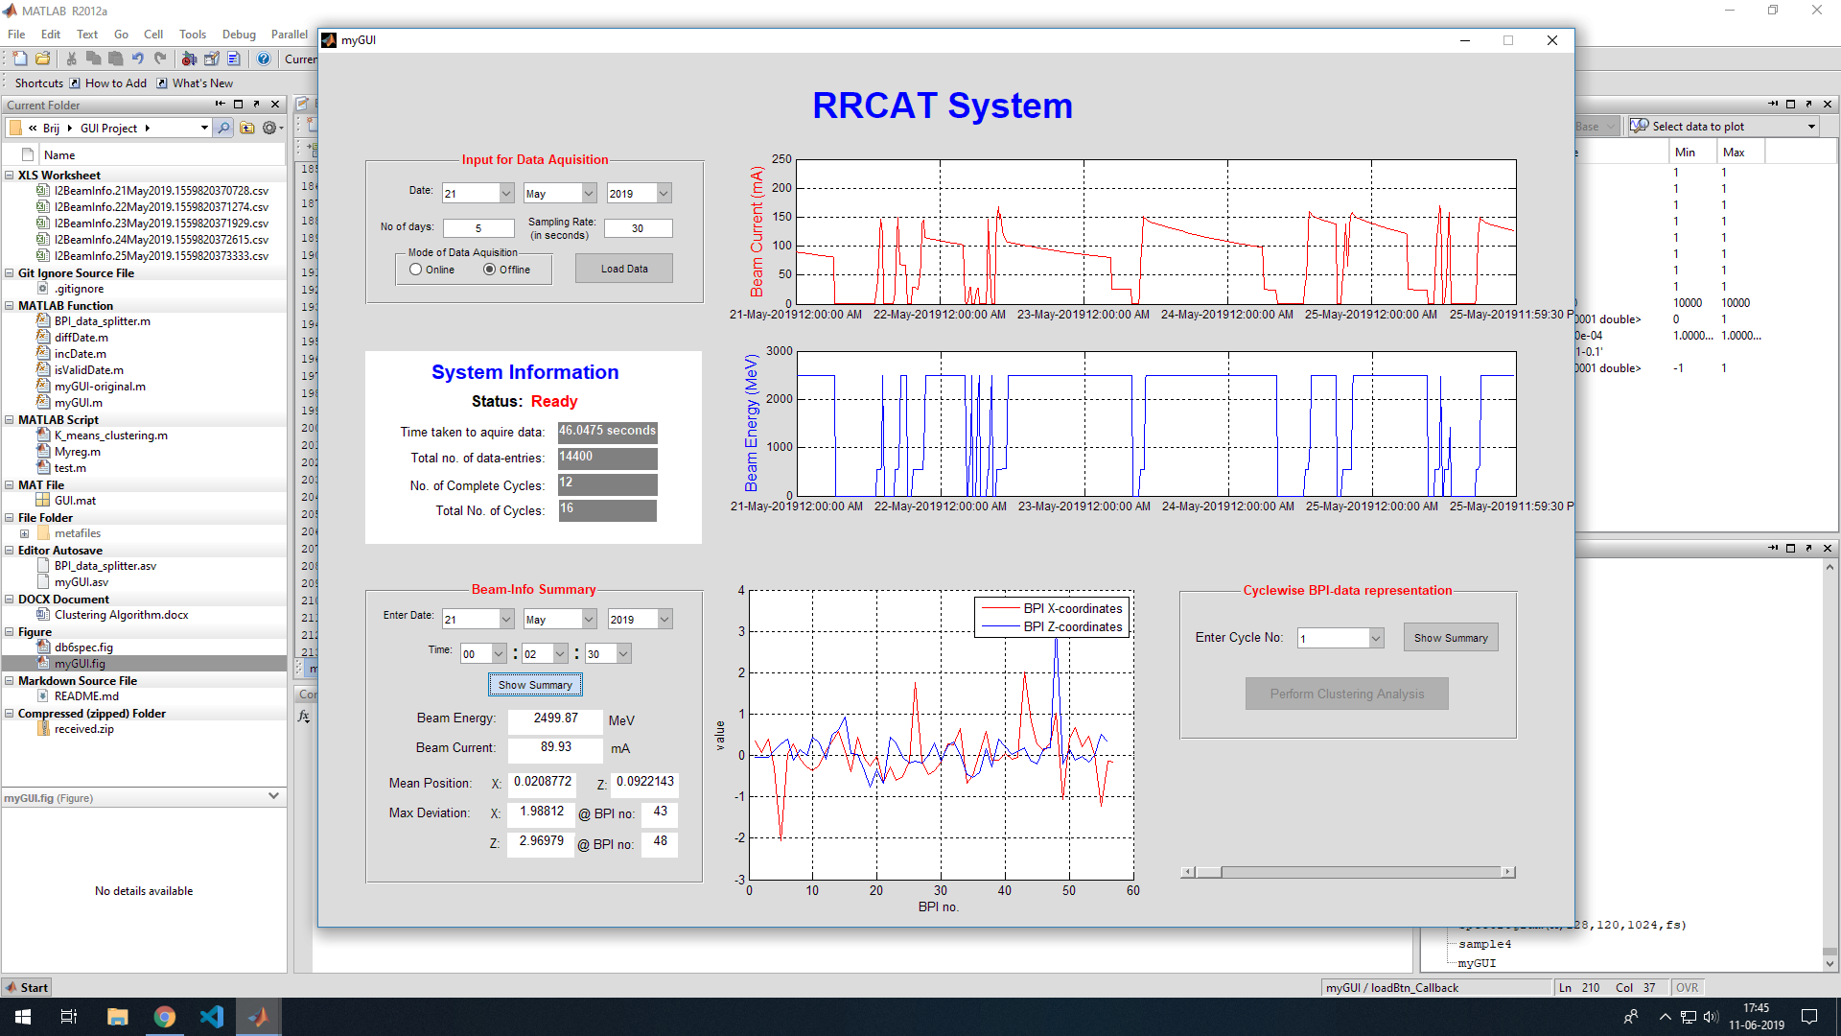
GUI-a synopsis

Slide 12
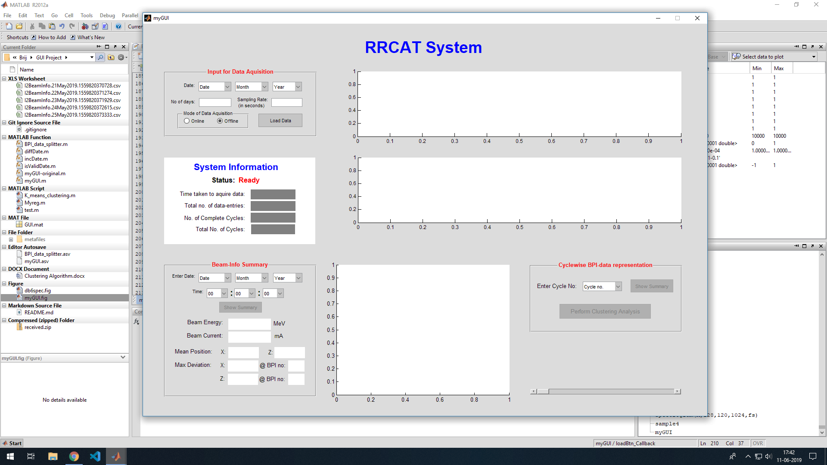

Slide 13
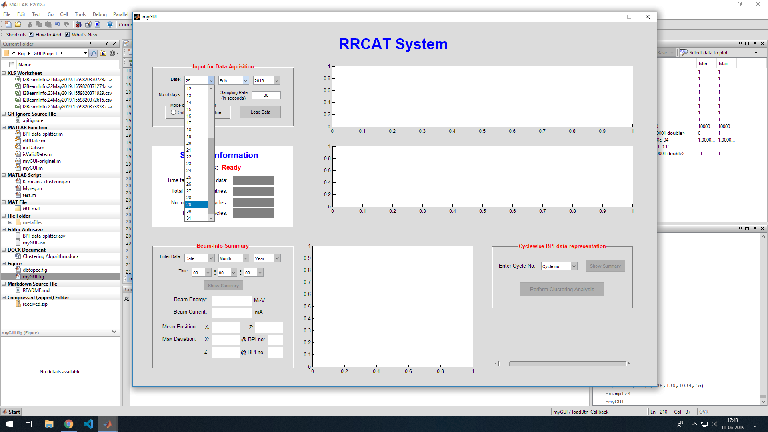

Slide 14
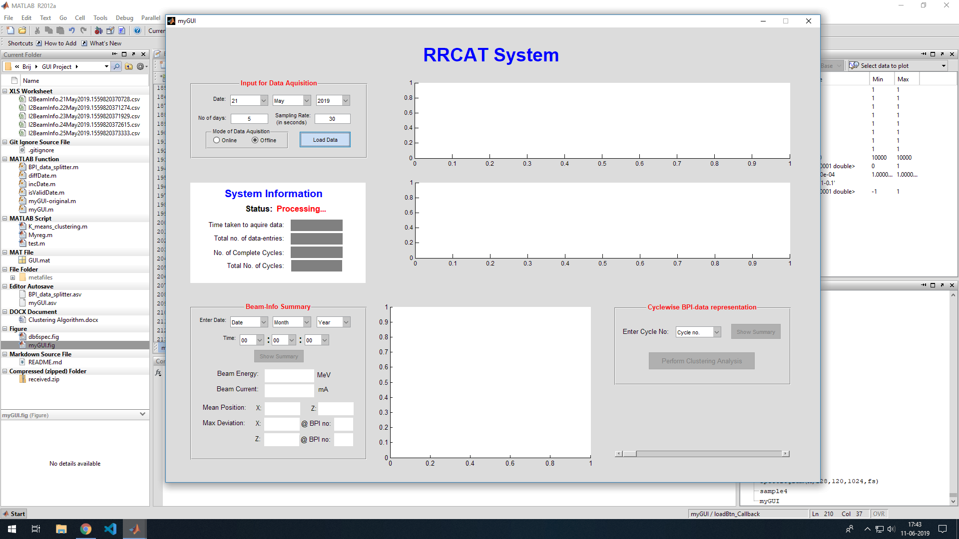

Slide 15
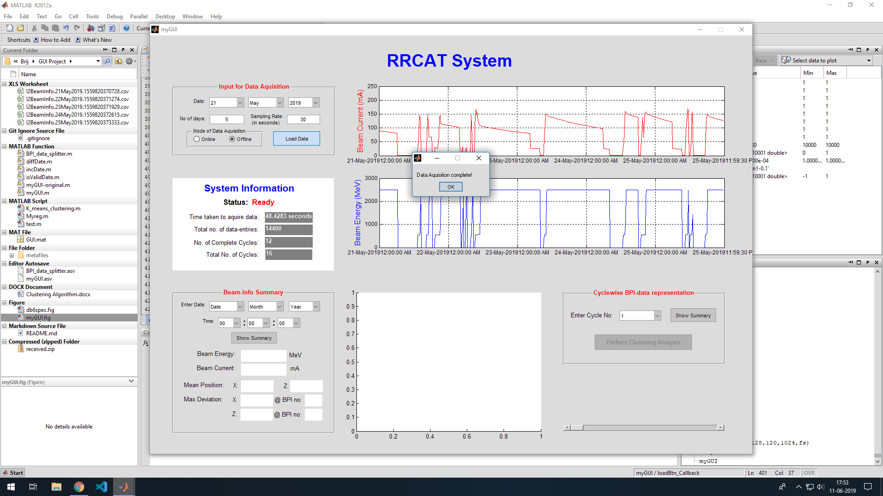

Slide 16
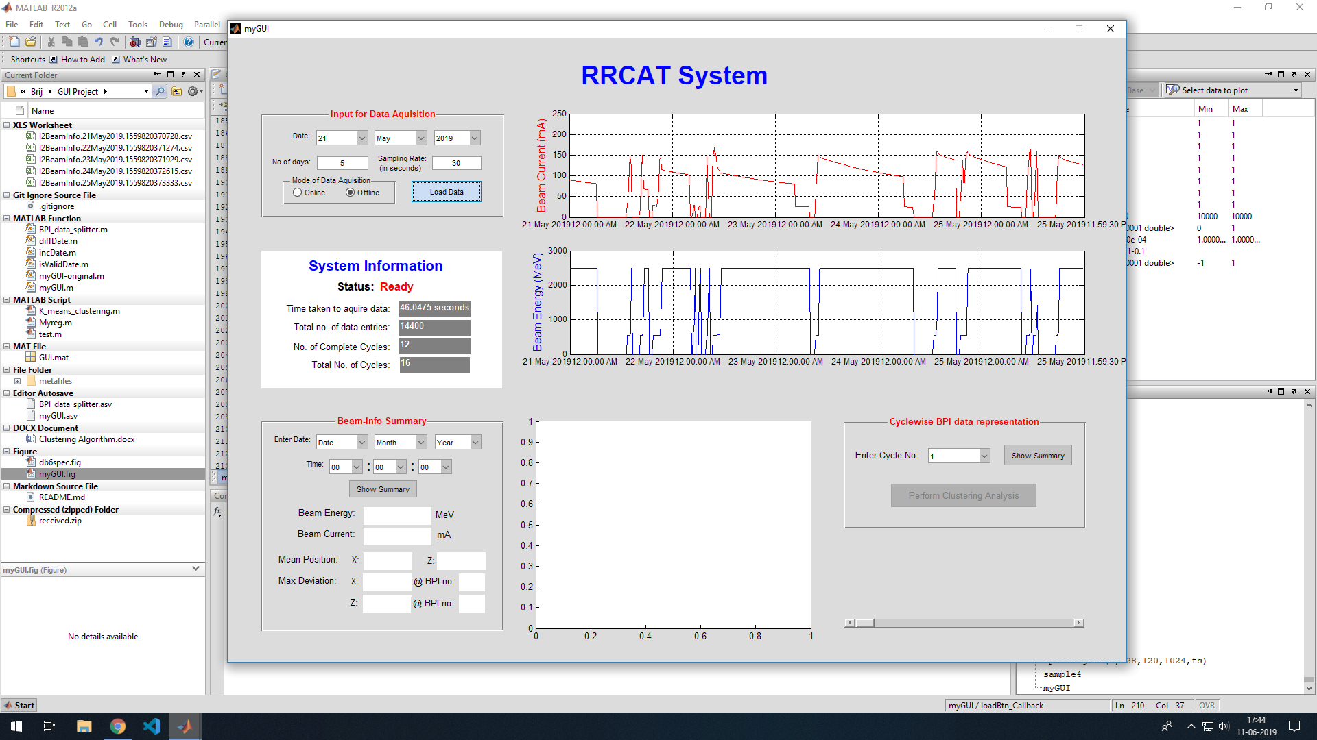

Slide 17
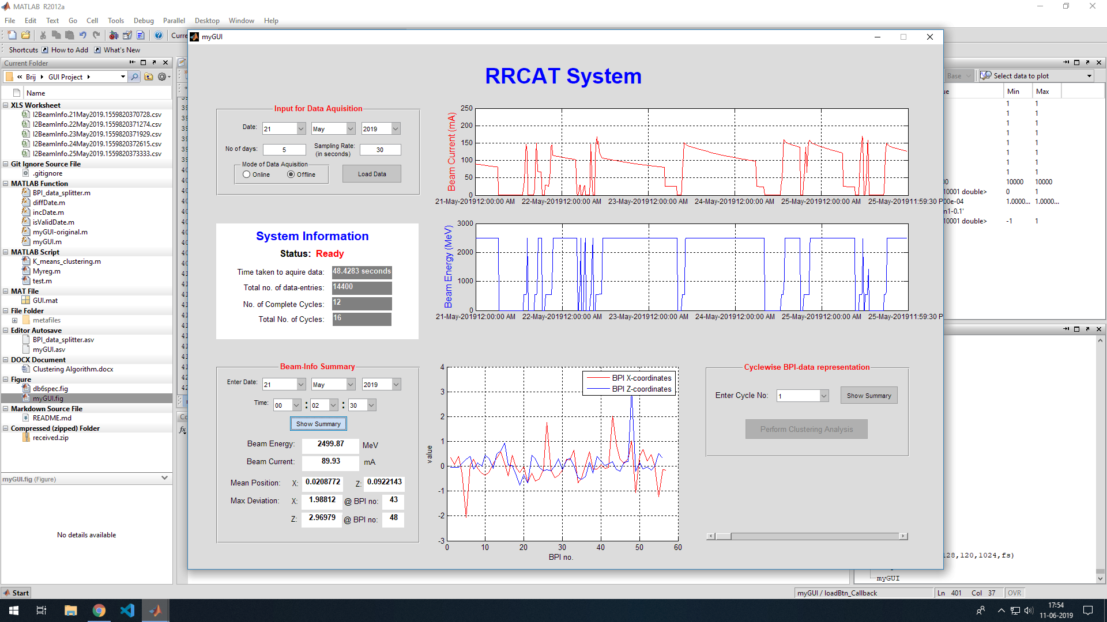

Slide 18
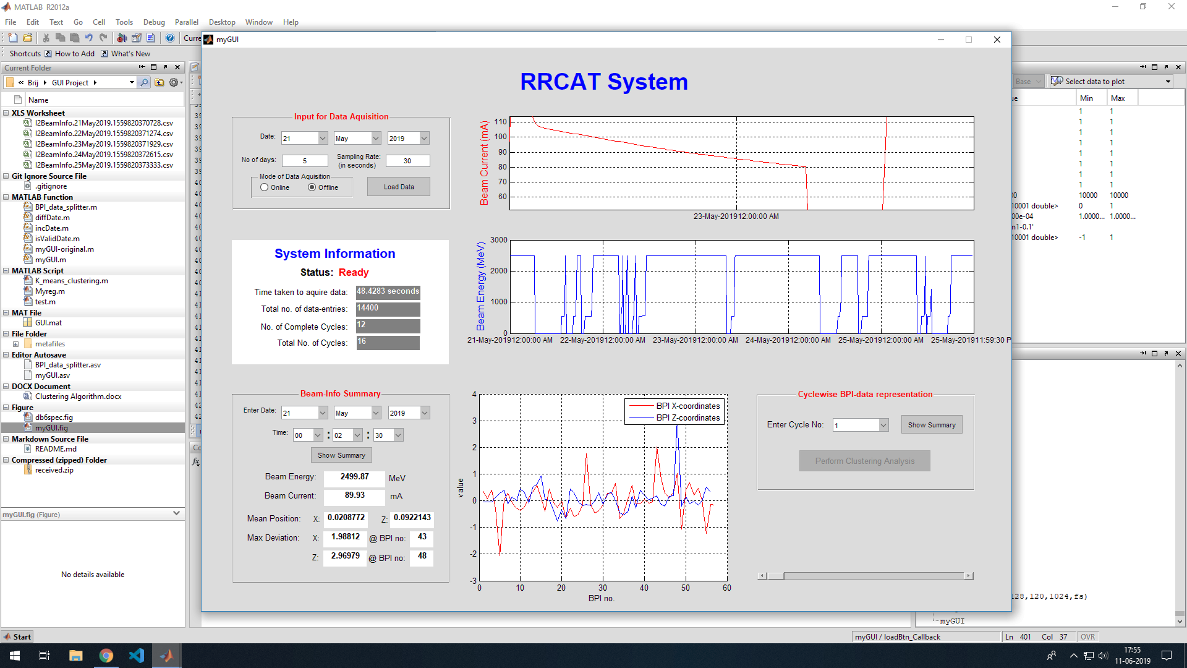

Slide 19
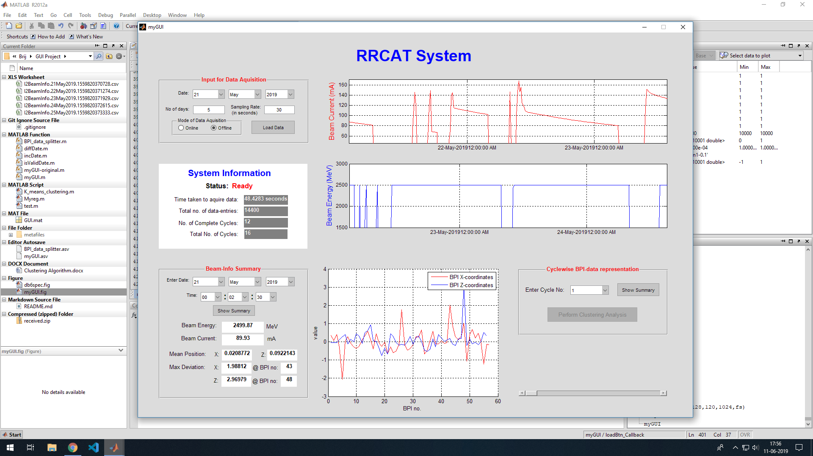

Slide 20
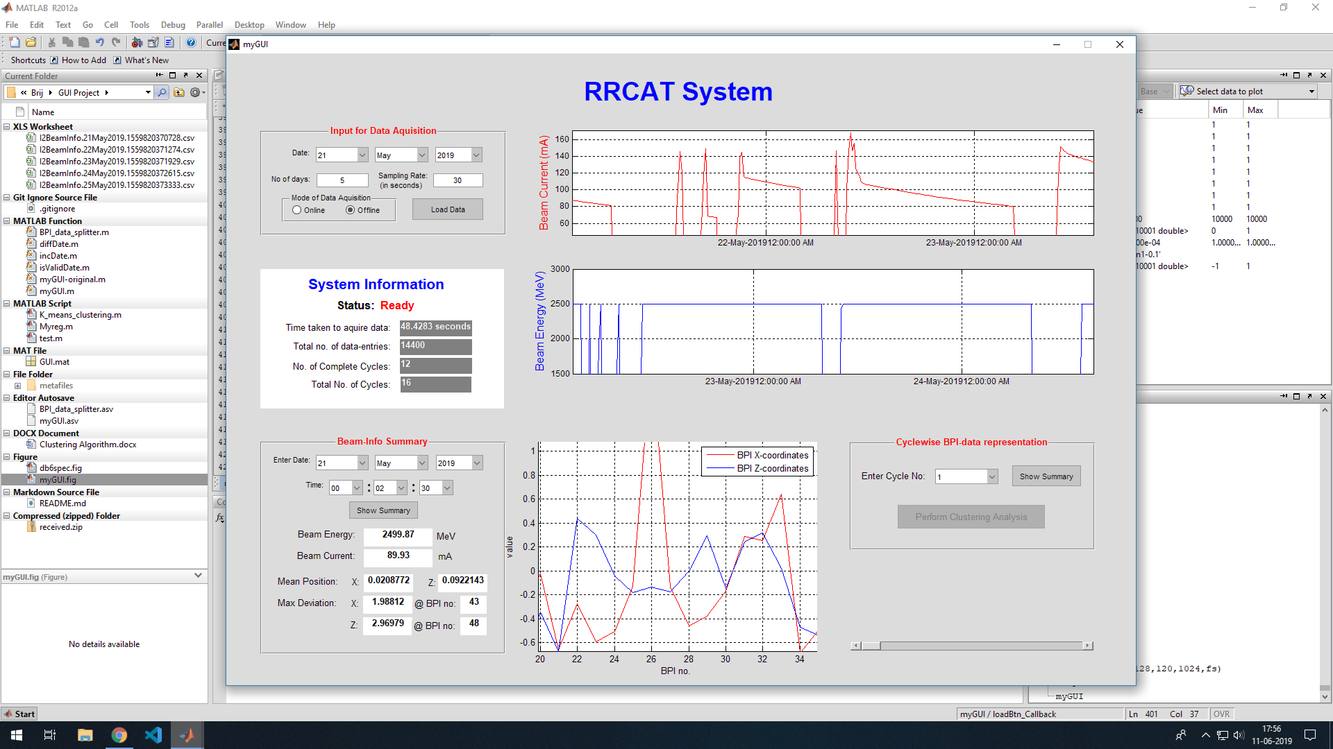

Slide 21
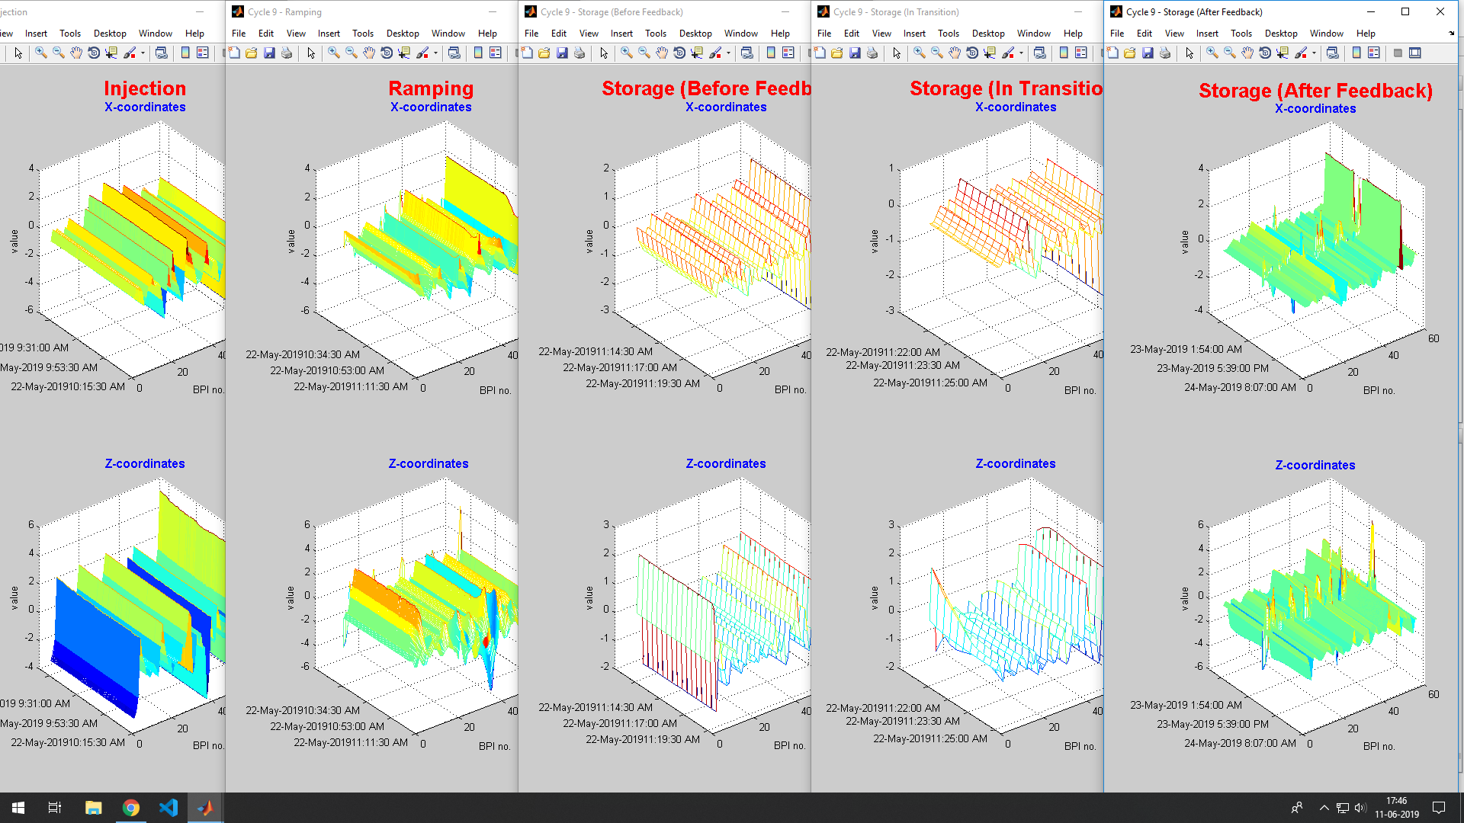

Slide 22
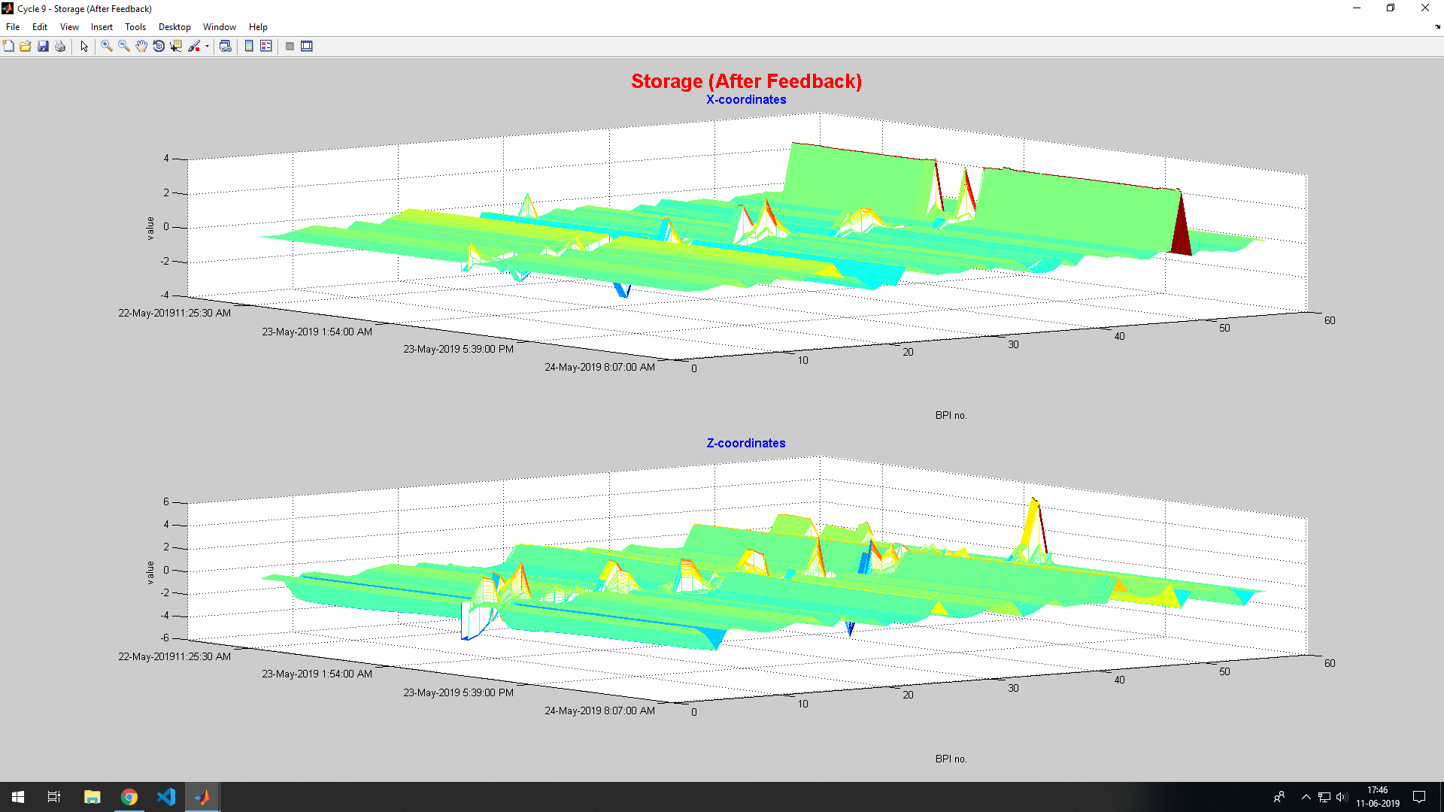

Slide 23
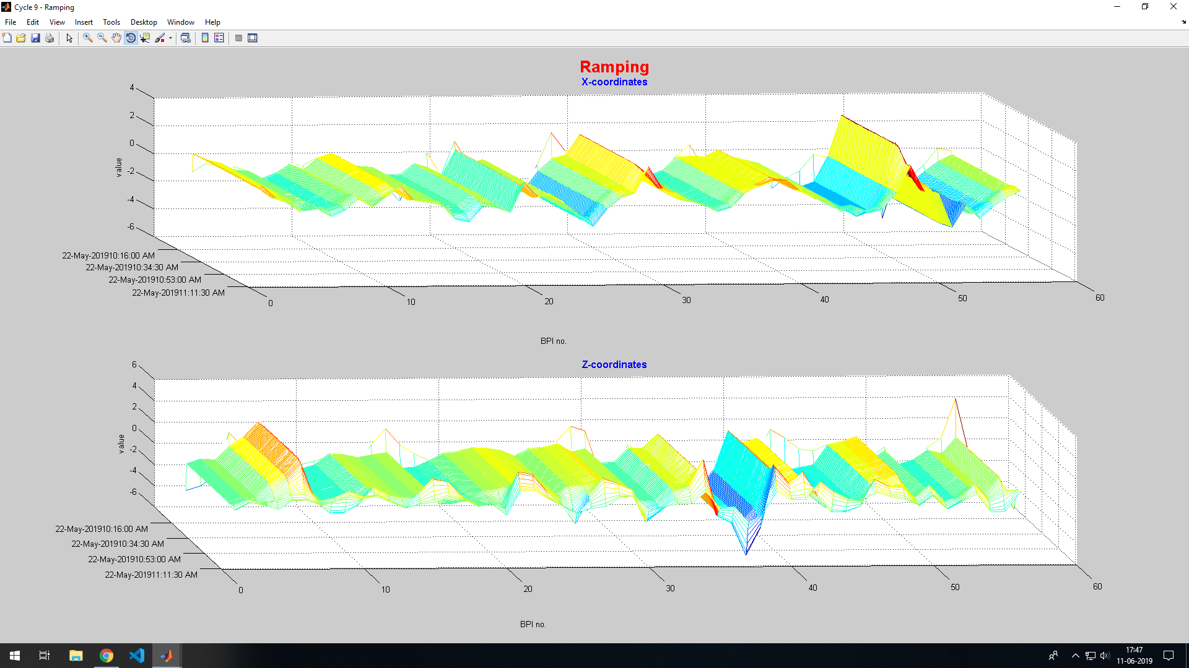

Slide 24
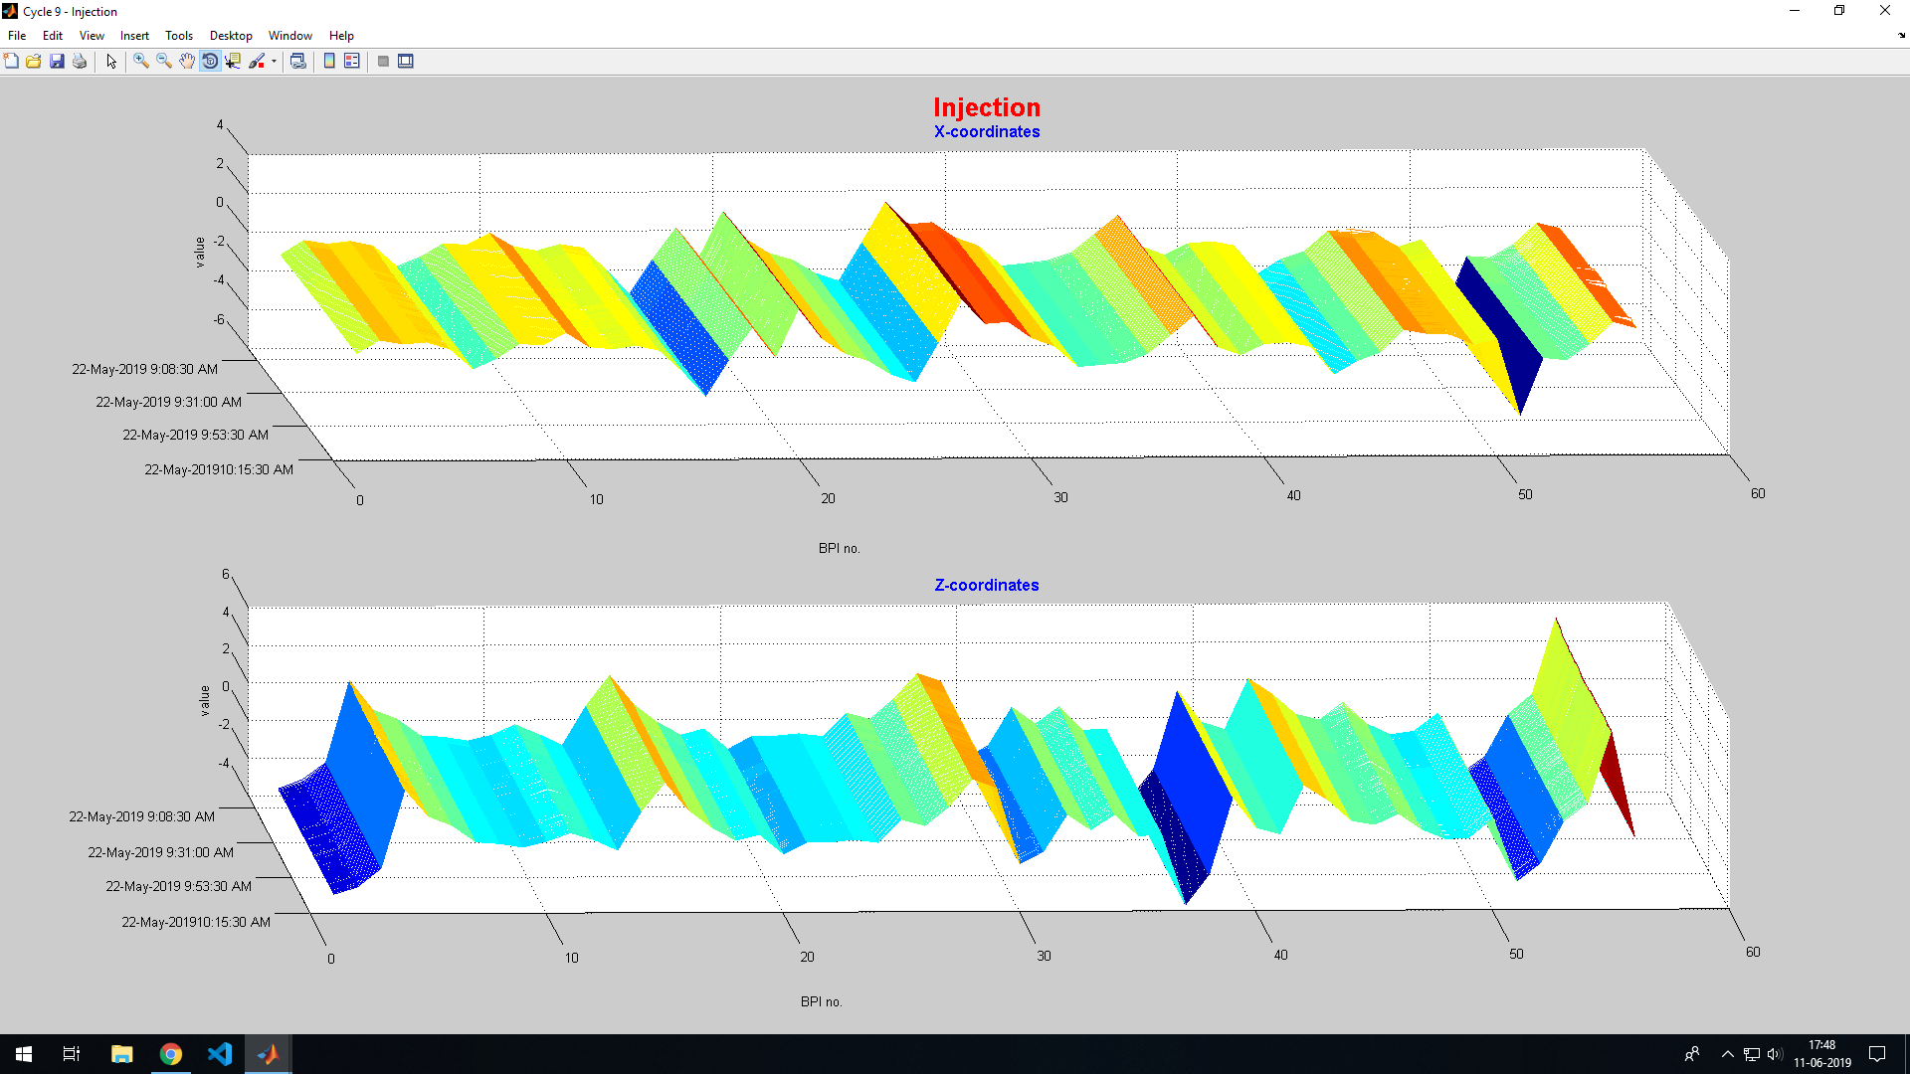

Slide 25
Error Handling:
Preventing the Unwanted….

Slide 26
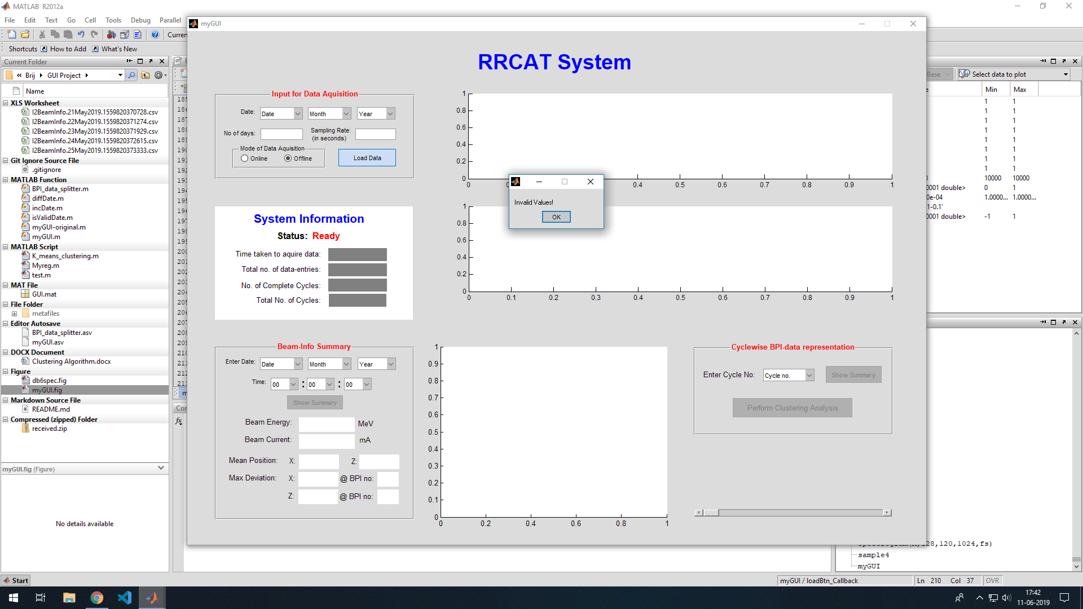

Slide 27


Slide 28
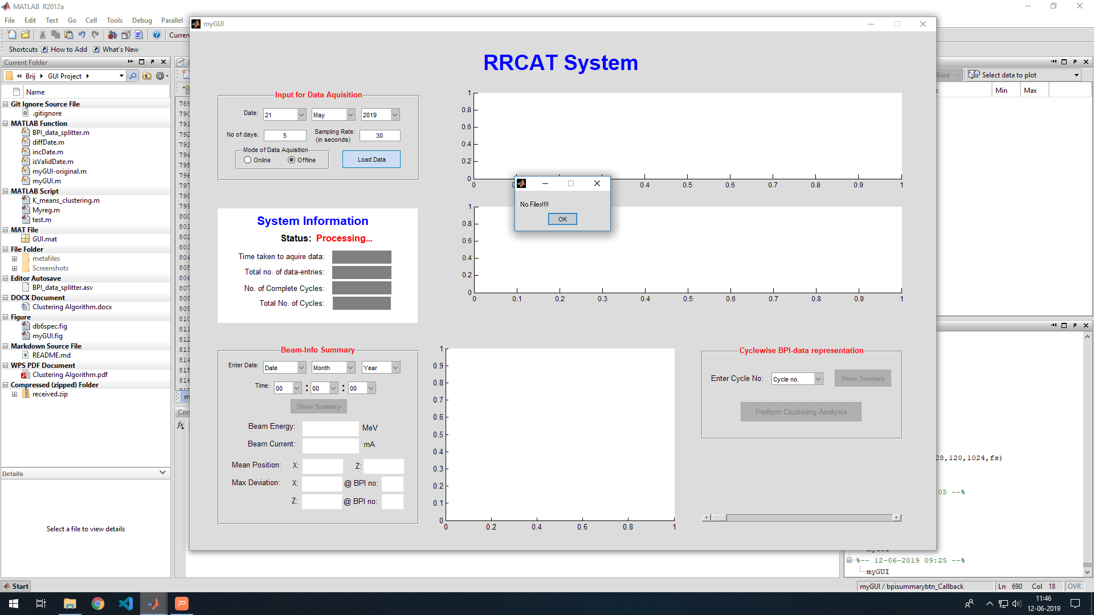

Slide 29
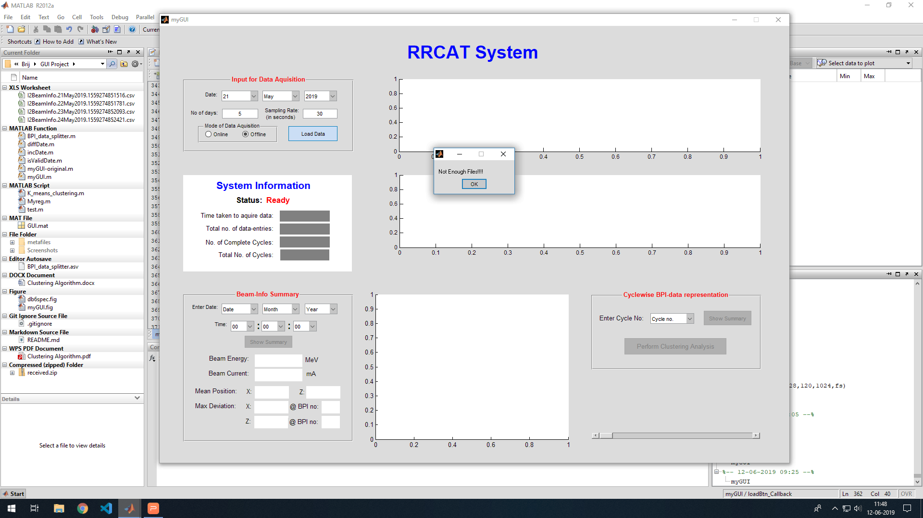

Slide 30
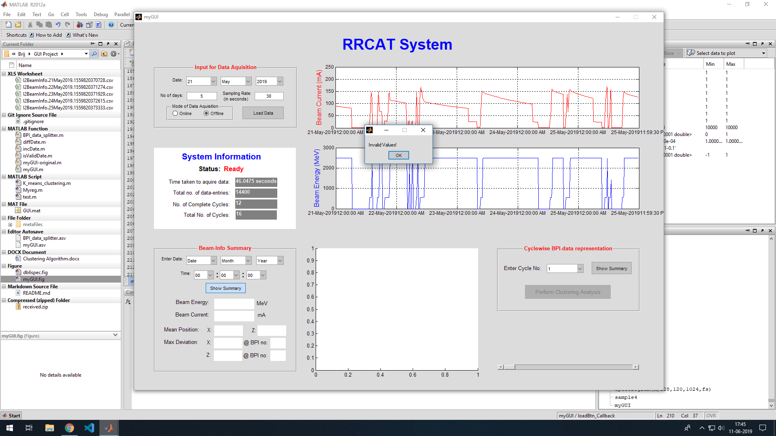

Slide 31
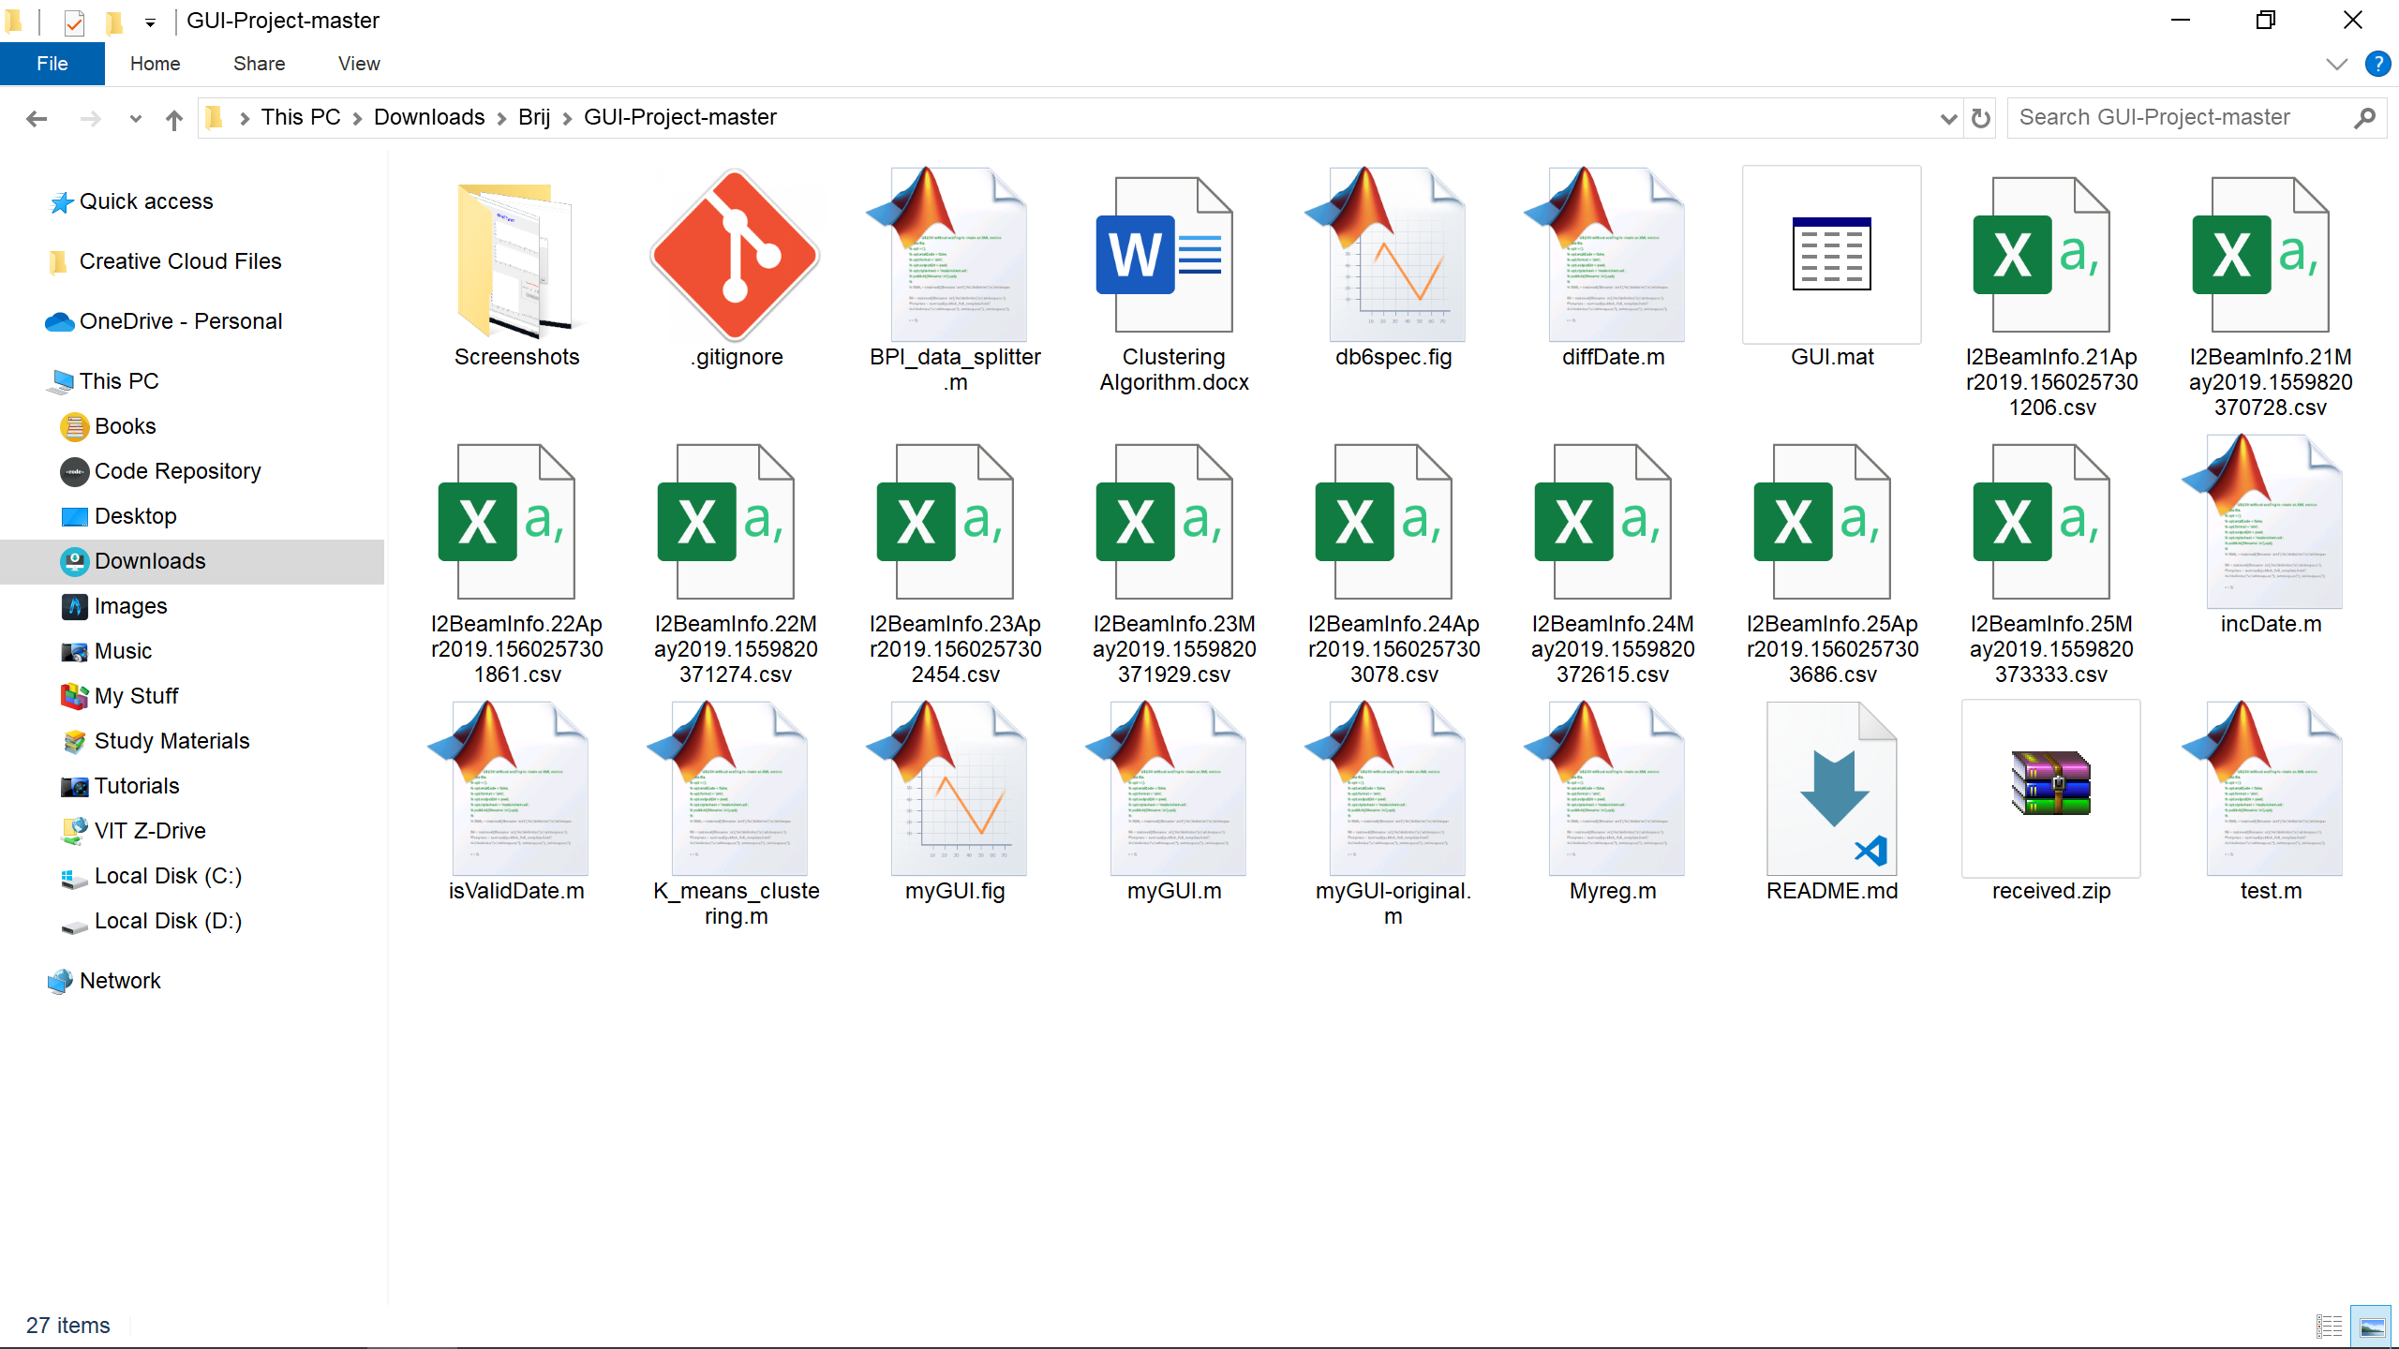


File Structure:
Cycle – 01.csv
myGUI.fig
myGUI.m
metafiles
Cycle – 02.csv
BPI_data_splitter.m
Cycle – ‘n’.csv
incDate.m
diffDate.m
validDate.m

Slide 32
Algorithms:
The behind-the-scenes logic….

Slide 33
Algorithm 1 - Data Aquisition:
Get the input of date, no.of days, sampling rate, & aquisition mode from user. If any errors, prompt the user and return.
If the mode is 'Online', Repeat the following for the no. of days specified:
Check if a file for the day in consideration is already present. If so, delete it.
Make an HTTP POST request to the following url, with the proper date & rate:
http://srs2.cat.ernet.in:8100/servlet/Indus2BeamInfoDataDownloadHA
Unzip the file obtained via the URL response.
Repeat for the rest of the days.
Obtain the list of all files with name of the form: 'I2BeamInfo*.csv'. If no such files are found, inform the user, and return.
Repeat the following steps, while the no. of files accepted are less than the no. of days required, and there are still some files left to scan:

Slide 34
Check if the file in consideration is having the data for the date required (by analysing the filename). If not, leave this iteration and continue.
Import the data from the file, and store in a variable 'data'.
for each data-entry in the 'data', repeat the following:
If the Current entry's Energy == 0 && Next entry's Energy == 0, leave the iteration.
If the Current entry's Energy == 0 && Next entry's Energy != 0, save the 'Next entry' as the start of a new cycle.
If the Current entry's Energy != 0 && Next entry's Energy != 0, leave the iteration.
If the Current entry's Energy != 0 && Next entry's Energy == '0', mark the Current Entry as the end of the cycle.
append the contents of the variable 'data' to a bigger data store, labelled 'beamData'.

Slide 35
If there are no more files to read, but we still need more files for the no. of days specified, display an error 'Not Enough Files' and return.
For Each Cycle thus identified, remove all entries with the value of current less than 1mA.
Call the 'BPI_data_splitter' function, and store the returned values in the global handle.
Activate all the relevent buttons that use the aquired data in their computations.
Display a message 'Data Aquisition Complete!'.
Plot the graph for the Beam Energy and Beam Current.

Slide 36
Algorithm 2 - Getting and Splitting BPI data:
Truncate the contents of the 'metafiles' folder.
Initialize variables: cycleData, BPIdata, nComplete.
Repeat the following steps for each identified cycle:
Obtain the first date & time entry of the cycle in consideration.
calculate the rounded-up duration of the cycle, in hours, as follows:
Duration = 24 x (End date - First Date) + Hours(First Time entry) + 1
make a HTTP POST request to the following URL, with the first date & time entry, and the calculated duration:
http://srs2.cat.ernet.in:8100/servlet/Indus2BPIDataDownloadHA
Unzip the file obtained as the response, rename it in the format: 'Cycle - n.csv', and move it to the 'metafiles' directory.

Slide 37
Import the renamed file. Append the contents to a data store, labelled 'BPIdata'.
Find the starting and ending points of the cycle from the data, and re-assign the value of 'data' between these points.
let inj = rmp = stg = 0;
For each entry in 'data', repeat the following:
if inj == 0 && Energy <=550: inj=current index.
else if rmp == 0 && Energy <=550 && difference in energy b/w index and index+1 > 0.5: rmp=current index.
else if stg == 0 && Energy >2490 && difference in energy b/w index and index+1 < 0.5: stg=current index.
if inj & rmp & stg != 0: nComplete++;
if inj !=0:
if rmp & (rmp-1) != 0: stages.inj = data(inj:rmp-1);
else stages.inj = data(inj:end);
if rmp != 0:
if stg & (stg-1) != 0: stages.rmp = data(rmp:stg-1);
else stages.rmp = data(rmp:end);

Slide 38
if stg != 0:
make an HTTP GET request to the following url, with date & time entry, a duration:
http://srs2.cat.ernet.in:8100/servlet/I2TuneSOFBHistoryHA
in the response string, search the pattern: '>\d</B></font>'.
Filter the results, and transform the results from a [7n*1] matrix into a [n*7] matrix. This matrix has the numerical data of the SOFB system.
in the response string, search the pattern: '>[-:. 0-9]{21}</B></font>'
Filter the results, and the matrix thus obtained contains date & time entries of the data.
let brk = 0;
for each row, check if Hori_status OR Vert_status ==1. If so, brk=row_index.
if brk == 0: stages.nofeed = data(stg:end);
else:
start = index(date(data) == date(brk));
finish = start + (300/rate);
if start != stg: stages.nofeed = data(stg : start-1);
if (finish+1) < no. of rows in 'data':
- stages.trans = data(start : finish);
- stages.feed = data(finish+1 : end);
else:
- stages.feed = data(start : end);
append 'stages' to 'cycleData'
return cycleData, BPIdata, and nComplete.

Slide 39
Algorithm 3 - Displaying Beam-Info Data:
Get the input of date & time from user. If any errors, prompt the user and return.
Search the 'BPIdata' store for the data-entry of the date specified.
If not found, display an error 'Data not found', and return.
Display the Ebergy and Current values from the searched entry.
Separate-out the values of X & Z coordinates of the BPI data, and plot them.
Display the mean values of X & Z coordinates.
Calculate the deviations of each entry from the corresponding mean values, and display the entries with the max devaitions, along with their BPI no.

